Slide 1
Integration of Information Models and Tools
Informational Brief (Post HL7 Meeting)
HL7 Project Scope Statement (PSS)
For Achieving Computable Interoperability with a
HL7/ISO “Common Logical Information Model (CLIM)”
Presented to
FHA Managing Board, November 2, 2016
Presented by
Steve Wagner and Nona Hall
On Behalf of
DoD, VA & External Partner SMEs

Slide 2
Approach
Our clinical goal is to help people live the healthiest lives possible by enabling a “Learning Health System” supporting areas such as, but not limited to, Precision Medicine, Clinical Decision Support, Genomics, Research, etc.
This requires data that is computable, usable, extensible, and interpretable across disparate systems - a state that currently does not exist
The proposed solution capitalizes on the inroads made with the exchange of data, standards and standards adoption, but brings back a focus on the data in order to make additional and necessary advancements
.

Slide 3
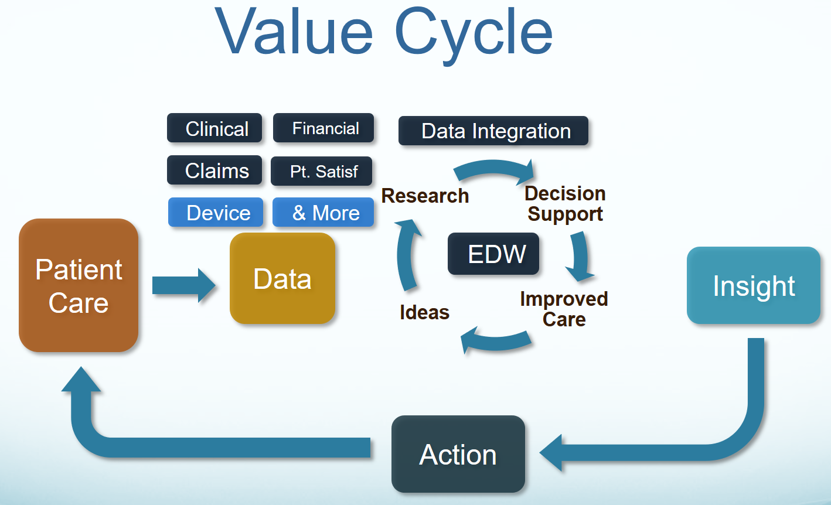
IT Objective
Our IT objective is to make the appropriate data available
when it is needed, where it is needed and how it is needed.

Slide 4


Proposed Solution: Integration of Information Models Enabled by Tools
KNART
KNART
KNART
DCM
DCM
DCM
DCM
DCM
CQI
C QF
CDS
DCM
DCM
Other
Initiatives
DCM
CIMI
FHIM
DCM
DCM
DCM - Detailed Clinical Models
FHIM – Federal Health Information Model
KNARTS – Knowledge Artifact
SOLOR – SNOMED, LOINC, RxNorm
SOLOR
See Notes Page

Slide 5
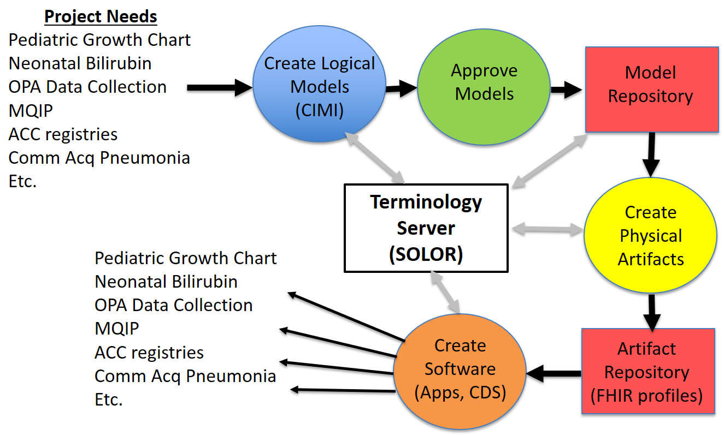

Better Implementation Products: Apps Based on Integrated/Reusable Models
CLIM
{SOLOR, FHIM, CIMI, CQF, …}
CLIM
(HL7/ISO
Balloted
Version)
ACC is American College of Cardiologists, COMM Acq is Community-acquired,
MQIP is Medicare Quality Improvement Program, OPA is Oropharyngeal Airway

Slide 6
Chronology
Jan 2016 HL7 FHIM-CIMI Investigative Study
Apr 2016 CIMI Task Force
Aug 2016 IPO HIEA Technical Forum on Models Integration
SOLOR/FHIM/CIMI/CQF/DAF+
Aug 2016 Preliminary Report
Sep 2016 Final Report
Sep 2016 FHA Managing Board Pre-HL7 Informational Brief
Sep 2016 HL7 FHIR Workgroup Coordination
Sep 2016 HL7 Meeting, HL7 PSS Submitted for Coordination
Oct 2016 JIF Proposal submitted
Nov 2016 FHA Managing Board Brief
Nov 2016+ Next Steps including Pilot Engagement Activities

Slide 7
Ongoing Work
HL7 Clinical Information Model Initiative (CIMI) weekly telecoms
These calls also address FHIM, CQF, DAF+ & SOLOR requirements
HL7 Patient Care (PC) weekly telecoms
FHIM weekly telecoms
Submission/support-to IPO JIF Pilot Proposal(s)
Evaluation of Potential Pilots and Governance
Finalize HL7 PSS Coordination
Federal Partners Endorsement
HL7 Architecture Review Board
HL7 Technical Steering Committee
Projects Underway
HL7 PC WG Skin Assessment
HL7 EHR WG Immunization Projects
IPO HIEA FHIR JET Proving Ground leveraging SIGG (models/tooling)

Slide 8
Planned Product Schedule
Ad-hoc Pilot Implementation Guides and Lessons Learned
Practitioners’ Guide updates
2017Q4 HL7 Informative Ballot *
2018Q4 HL7 Draft Standard for Trial Use (DSTU) 1 *
2019Q4 HL7 Draft Standard for Trial Use (DSTU) 2 *
2020Q4 HL7 Normative Standard *
2021Q4 ISO Normative Standard *
Note *
US Realm CLIM contains
Versioned SOLOR, FHIM, QICore, DCMS, KNARTS, DAF
FHIR Profiles, Extensions and Implementation Guides
ISO (International Realm) CLIM contents TBD
ISSUE (to be resolved): RxNorm, QICore & DAF are not currently international

Slide 9
HL7 Coordination
The following HL7 Workgroups Supporting PSS
Clinical Information Model Initiative (CIMI)
Clinical Quality Information (CQI)
Clinical Decision Support (CDS)
Clinical Interoperability Council (CIC)
Community Based Collaborative Care (CBCC)
Electronic Health Record (EHR)
Health Standards Integration (HSI)
Patient Care (PC)
Architecture Review Board (ARB)
Technical Steering Committee (TSC)

Slide 10
Federal Agency Coordination
Co-Sponsors
DoD/VA IPO - Loren Thompson
ONC/OST - Steve Posnack
FHA - Gail Kalbfleisch
Core SMEs
Steve Wagner (FHIM focus)
Keith Campbells (SOLOR focus)
Julia Skapik (CQF focus)
Stan Huff (CIMI focus)
Project Facilatars
Nona Hall
Steve Hufnagel
PSS Proponents
DoD – Nancy Orvis & Bart Bartholomew
VA – Keith Campbell & Bob Bishop
FDA – Mitra Rocca
CDC - Nicolay Lipskiy
ONC/OST - Julia Skapik
SAMHSA – Ken Salyards

Slide 11
WBS Task – FTE Estimate (1 of 3)
Pilot Projects (2-4/yr., 4-6mo cycles) - 5.00 FTEs estimated
Requirements and use case analysis
FHIM refactoring/maintenance/use
CIMI refactoring/maintenance/use
SOLOR refactoring/maintenance/use
ISAAC tool refactoring/maintenance
SOLOR terminology server maintenance
CQI/CQF/DAF+ harmonization and use
SIGG (MDHT + MDMI) model harmonization, mapping and implementation
FHIR and other implementation artifacts and support
Tool documentation, training and support for pilot SMEs
Coordination & facilitation
Change control and configuration management
PMP and WBS maintenance

Slide 12
WBS Task – FTE Estimate (2 of 3)
Governance - 1.25 FTE
Assess and execute follow-on governance oversight
HIEA, FHA, HL7 transition to recommended TLC (Technical Learning Community)
Assess and execute governance of assets and infrastructure
FHIM, CIMI, SOLOR, CQF and DAF+ facilitation
Change Control and Configuration Mgmt. facilitation
HL7 CIMI & FHIR Ballot processes
Consolidated SOLOR/ FHIM/CIMI/CQF Architecture for FHA/Federal Partners
EHRS Functions, Use Cases and Requirements
Information and Terminology Models Profiles
System APIs
Standards Profile
Tools, Tool Content, tool training

Slide 13
WBS Task – FTE Estimate (3 of 3)
Communications - 1.25 FTEs
Communication Plan development and maintenance
SDO work group participation, presentations & facilitation
“CLIM Practitioners Guide” maintenance
“Models &Tools Guide” for non-engineers
DoD, VA, Federal, Industry, Academia Outreach
HSPC, Argonauts, SMART, OpenGroup, ONC TLC
Activity, Status and Progress Reports
Slide Master Deck maintenance
Web Sites content maintenance
Max.gov, VCS, HL7, OpenCIMI.org, TLC, repositories
Training materials development, availability, maintenance, distribution

Slide 14
Support Requested
Continuance of Efforts per HL7 Project Scope Statement (PSS)
for
Integration of Information Models and Tools
Questions?

Slide 15
Details
Supporting documents are viewable and downloadable at
HL7 Project Scope Stmt. https://1drv.ms/w/s!AlkpZJej6nh_k9dYlvNWaZ3DLPKSYg
Briefing Slides https://1drv.ms/p/s!AlkpZJej6nh_k9dE-b_DAO8HSNNT6Q
Slides-Notes Pages PDF https://1drv.ms/b/s!AlkpZJej6nh_k9daUH18BNQFOwtNrg
Final Report https://1drv.ms/w/s!AlkpZJej6nh_k9dQ2qQnRuQM8gbu8A
Technical Forum Summary https://1drv.ms/w/s!AlkpZJej6nh_k9gyRVADgOvM5SlJkQ
Preliminary Report https://1drv.ms/w/s!AlkpZJej6nh_k9YPmsR8Hl6zTlQ0NQ
Work Breakdown MPP https://1drv.ms/u/s!AlkpZJej6nh_k9dK5WOB8zkkUuaKgA
Work Breakdown PDF https://1drv.ms/b/s!AlkpZJej6nh_k9dfYSeXPGjTRJ2cAg
Work Breakdown XLSD https://1drv.ms/x/s!AlkpZJej6nh_k9dgBSgLrTfaKYcG2A
CLIM Practitioners’ Guide https://1drv.ms/w/s!AlkpZJej6nh_k6ZUeG7W6TaWcbTZ4Q
Note that many networks block the use of clickable links; where,
You must copy the link into a browser to access the content.

Slide 16
Acronyms
CDC | US Center for Disease Control | ISAAC | VA tool for SOLOR
CDS | Clinical Decision Support | ISO | International Standards Organization
CIMI | Clinical Information Model Initiative | JIF | VA/DOD Joint Incentive Fund
CQI | Clinical Quality Information | KNART | Knowledge Artifact
CQF | Clinical Quality Framework | LOINC | Logical Observation Identifiers Names and Codes
CLIM | Common Logical Information Model | MDHT | Model Driven Health Tool
DAF+ | Data Access Framework plus other models and extensions | MDMI | Model Driven Message Interface
DCM | Detailed Clinical Model | ONC/OST | US Office of the Natl. Coordinator / Office of Science and Tech.
DOD | US Department of Defense | PMP | Program Management Plan
DSTU | Draft Standard for Trial Use | PSS | Project Scope Statement
EDW | Electronic Data Warehouse | RXNORM | US National Library of Medicine naming system for drugs
FDA | US Federal Drug Agency | SIGG | Standards Implementation Guide Generator
FHA | US Federal Health Architecture | SOLOR | SNOMED extension for LOINC & RXNorm
FHIM | US Federal Health Information Model | TLC | ONC/OST Technical Learning Center
FHIR | HL7 Fast Health Information Resource | VA | US Veterans Administration
HIEA | DoD VA IPO Health Interoperability Exchange Alliance | VCS | Version Control System for for collaboration
HL7 | Health Level Seven | WBS | Work Breakdown Structure
IPO | US DoD and VA Interagency Program Office

